Slide 1
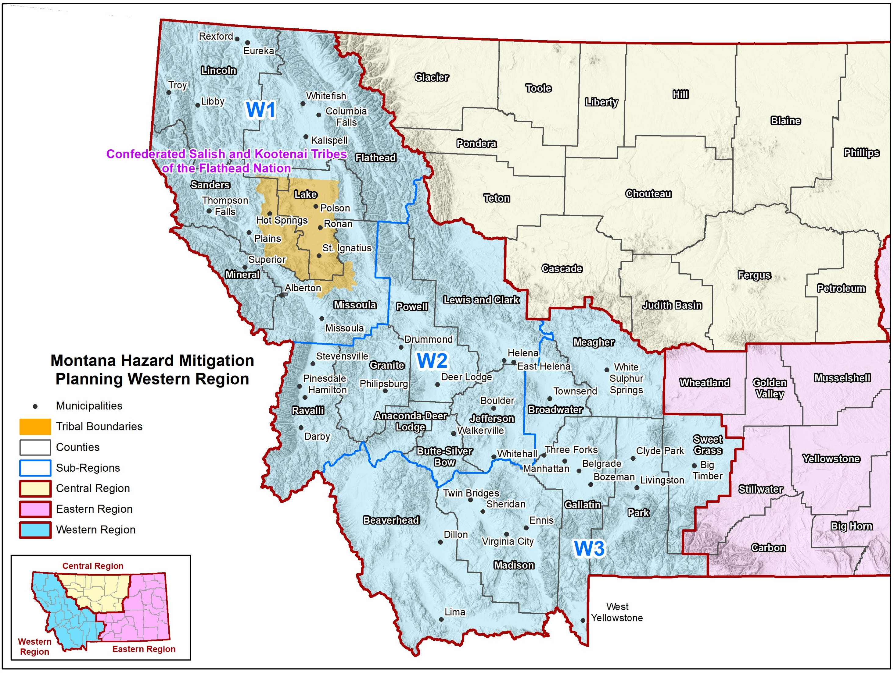
State of Montana Western Region Hazard Mitigation Plan
Hazard Mitigation Planning Team –
Meeting #3 – Mitigation Strategy
January 17-20, 2023 – 10:00 AM – 3:00 PM

Slide 2
Agenda
Introductions
Planning process update
Review of possible mitigation activities and alternatives
Discuss criteria for mitigation action selection and prioritization
Funding mitigation options
Review of progress on existing mitigation actions (working lunch- provided)
Brainstorming Session: Development of new mitigation actions (group process)
Prioritize mitigation actions (group process)
Discuss plan implementation and maintenance
Review of draft HIRA
Next steps

Slide 3
Introductions

Slide 4
Introductions
Montana Disaster and Emergency Services
Sara Hartley – State Hazard Mitigation Officer
Andrew Long – Mitigation Coordinator
Ryan Lee – Western Region Supervisor
Audrey Walleser-Martin – Western Region Field Officer
Kyle Sturgill-Simon – Western Region Field Officer
County/Tribal Emergency Management Coordinators
Federal & State Partners
Other Stakeholders
WSP Project Team
Jeff Brislawn – Project Manger
Scott Field – Lead Planner, Central Region
Bob Vince – Project Principal, Local Support
Juliana Prosperi – Lead Planner, East Region
Christopher Johnson – Lead Planner, West Region
Mack Chambers – Lead GIS Analyst
Cameron Nelson – Hazard Mitigation Specialist
Natalie Schoen – Hazard Mitigation Planner
Emily Geery – SWCA Wildfire Risk Assessment Support
Victoria Amato – SWCA Wildfire Planning Specialist

Slide 5
Planning Process Update

Slide 6
FEMA’s Nine-Step Planning Process
Step 1 Determine the Planning Area and Resources
Step 2 Build the Planning Team
Step 3 Create an Outreach Strategy
Step 4 Review Community Capabilities
Step 5 Conduct a Risk Assessment
Step 6 Develop a Mitigation Strategy
Step 7 Keep the Plan Current
Step 8 Review and Adopt the Plan
Step 9 Create a Safe and Resilient Community

Slide 7
Progress So Far
Kickoff meeting held May 26, 2022
Online public survey closed October 2022
174 total responses received
Risk Assessment Meeting held September 12th, 2022
GIS analysis & mapping completed
Draft HIRA completed and sent to HMPC for review
Mitigation Workshops (Time: 10am -3pm)
Jan 17th Helena : Physical Location: Fort Harrison (HFRAC) Address: 1956 Mt. Majo. St. Ft. Harrison, MT 59636
Jan 18th Kalispell: Physical Location: Flathead County Dispatch and Emergency Operations Center Address: 625 Timberwolf Parkway Kalispell, MT 59901
Jan 20th Livingston: Physical Location: City-County Complex (Courthouse) Address: 414 E. Callender St. Livingston, MT 5904

Slide 8
Review of Possible Mitigation Activities and Alternatives

Slide 9
Hazard Mitigation Examples
Reduce the future demand for, and rising costs of, disaster response and recovery.
Retrofit a critical facility, enforce building codes, land use planning, remove a structure from a hazard area.

Slide 10
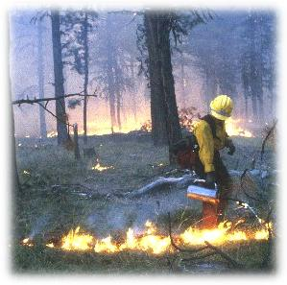
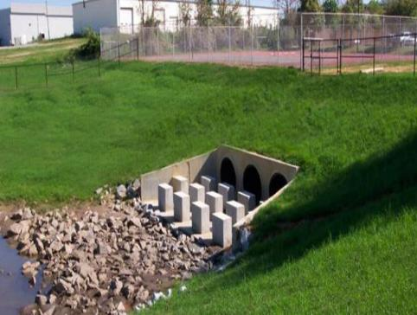
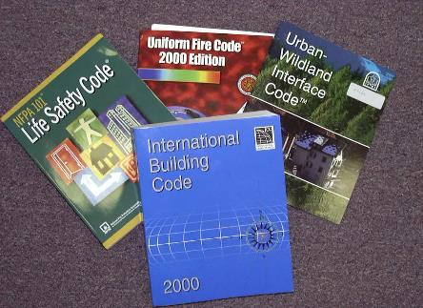
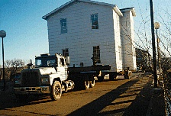
Review Mitigation Alternatives
► Alter
► Avert
► Adapt
► Avoid

Slide 11
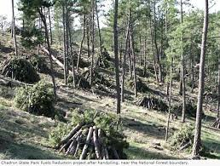
Review Mitigation Alternatives
► Alter the Hazard
Prescribed burns or fuels management to reduce wildfire intensity and severity
Draining lakes behind weakened dams

Slide 12
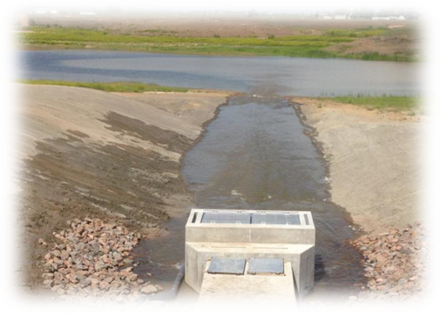
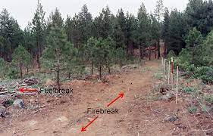
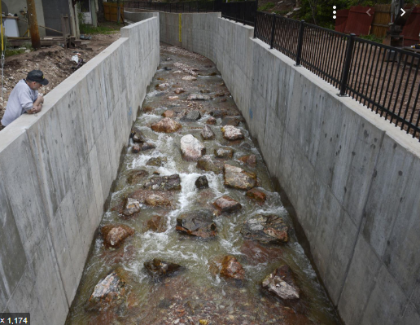
Review Mitigation Alternatives
► Avert the Hazard
Floodwalls and gates
Debris Nets and Basins
Drainage improvements
Channels and culverts
Firebreaks

Slide 13
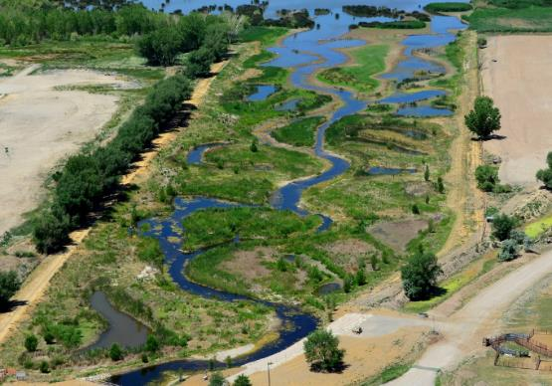
Review Mitigation Alternatives
► Avoid the Hazard
Acquisition
Relocation
Open space
Land use designation
Natural system protection

Slide 14
Review Mitigation Alternatives
► Adapt to the Hazard
Building codes
Construction standards
Land use and development regulations
Design standards
Monitoring and warning systems
Safe rooms and shelters

Slide 15
FEMA Mitigation Action Categories
Plans and Regulations
Structure and Infrastructure Projects
Education and Awareness
Natural Systems Protection

Slide 16
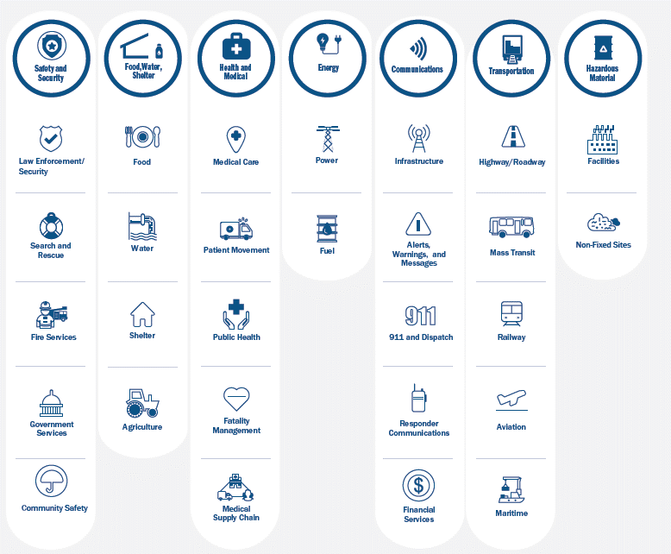
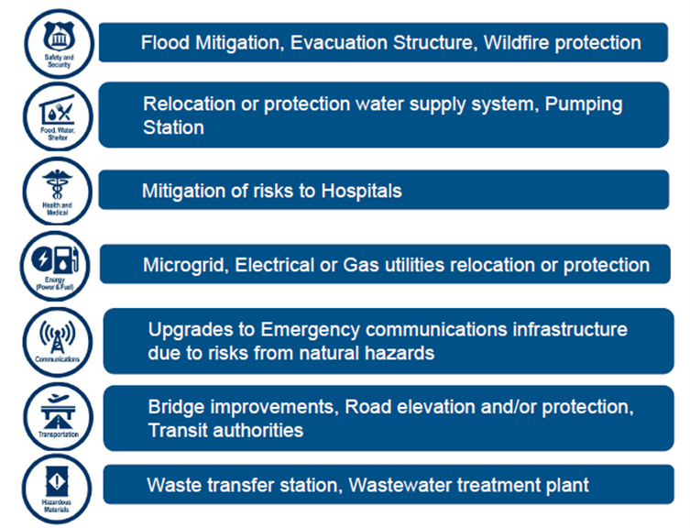
FEMA Community Lifelines

Slide 17
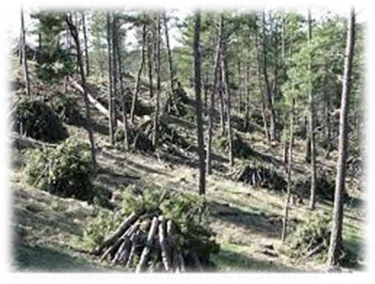
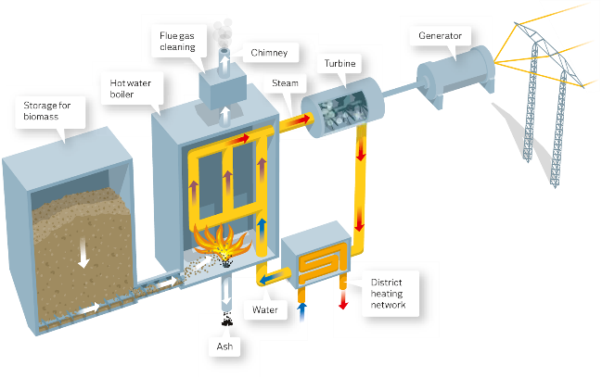
Projects Eligible for FEMA Funding - Wildfire
Defensible space
Structural protection through ignition-resistant construction activities
Hazardous fuels reduction activities
Community level vegetation management
Vegetation removal
Vegetation clearing and/or thinning
Slash removal
Vertical clearance of tree branches
Biomass Plant

Slide 18
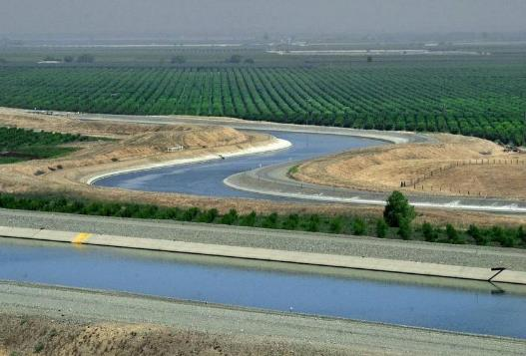
Projects Eligible for FEMA Funding - Flood Mitigation
Acquisition
Dry and wet flood-proofing
Elevation
Minor localized flood reduction projects
Detention ponds
Channel stabilization
New policy change: levee projects if no duplication of programs with Army Corps
Infrastructure retrofit
Culverts, bridges, etc.

Slide 19
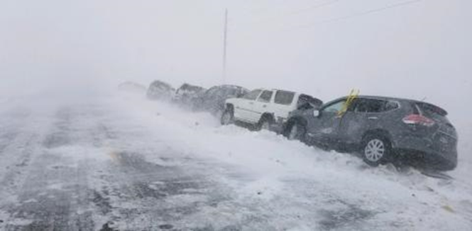
Projects Eligible for FEMA Funding – Winter Storm
Ensure development and enforcement of building codes for snow loads
Burying/hardening overhead power lines
Informing the public about severe winter weather impacts
Organizing outreach to vulnerable populations including establishing and promoting accessible heating centers
Retrofitting public buildings to withstand snow loads and prevent roof collapse

Slide 20
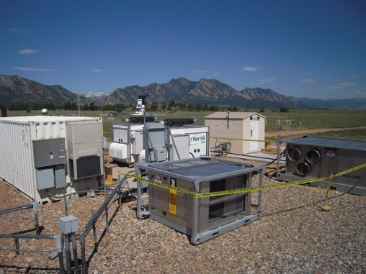
Projects Eligible for FEMA Funding (Other Hazards)
Landslides/geologic hazards
Channel or slope stabilization - protection of critical facilities
Property acquisition
Utility protection/ infrastructure retrofit
Safe rooms
Generators
Microgrids/smart grids
Seismic building/infrastructure retrofit
Climate resilient mitigation activities
Groundwater recharge
Green infrastructure

Slide 21
Things FEMA Will Not Count Towards The Requirement
“Conduct routine maintenance…”
“Develop a program…”
“Conduct a study…”
“Improvements were recently completed on…”
“Identify projects to reduce risk…”

Slide 22
Discuss Criteria for Mitigation Action Selection and Prioritization

Slide 23
Mitigation Action Selection and Prioritization
STAPLEE
Social
Technical
Administrative
Political
Legal
Economic
Environmental
Other Things to Consider
Life Safety
Vulnerable Populations
Addressing High Risk Hazards
Protect Critical Facilities/Assets
Multiple Goals/Hazards

Slide 24
Funding Mitigation Options

Slide 25
Funding Sources
Federal & state grants
Local/tribal budgets
Capital improvement budget
Healthcare Coalition
Public-private partnerships
Conservation coalitions
Fees/assessments/levies
Other?

Slide 26
FEMA Hazard Mitigation Grants
Projects must be tied directly to the mitigation goals, objectives, and specific actions in your HMP.
Most have 25% local match
HMGP: Hazard Mitigation Grant Program, post-disaster, all natural hazards
HMGP Post-Fire: available following an FMAG declaration
PA 406: Public Assistance Program Section 406, post-disaster, add mitigation measures to PA projects to avoid/reduce future damage
BRIC: Building Resilient Infrastructure & Communities, pre-disaster/annual cycle, all natural hazards, infrastructure emphasis
FMA: Flood Mitigation Assistance, pre-disaster/annual cycle, flood hazard, NFIP insured structures & communities
HHPD: High Hazard Potential Dam Program, pre-disaster/annual cycle, for non-Federal high hazard dams rated Unsatisfactory. (local match varies)

Slide 27
FEMA Preparedness Grants
Emergency Management Performance Grant
Homeland Security Grant Program
Tribal Homeland Security Grant
Nonprofit Security Grant
Transit Security Grant/Intercity Bus Security Grant
Port Security Grant
Assistance to Firefighters Grants
Regional Catastrophic Grant Program
National Earthquake Hazards Reduction Program Grant
Community Assistance Program

Slide 28
Other Grants
USACE
US DOT
BIA
HUD
EPA
USDA
USFW
CDC
BOR
NOAA/NWS
SBA
State of Montana grants?

Slide 29
Review of Progress on Existing Mitigation Actions

Slide 30
Mitigation Actions from Previous Plans
# | Jurisdiction | Action/Project Name & Description | Hazards Mitigated | Lead Agency | Partner Agencies | Cost Estimate | Potential Funding Sources | Schedule/ Timeline | Old Priority/ Ranking
1.1.1 | Anaconda-Deer Lodge | Create an Anaconda – Deer Lodge County Firesafe Council and Program. Promote mitigation practices in the wildland urban interface. Coordinate wildfire preparedness planning and activities. Build partnerships with community leaders and businesses, such as insurance providers, for wildfire prevention and mitigation. | Wildland and Forest Fires | Fire Departments |  | Little to no direct expenses | None needed | Near Term: Initiated within 0-3 years; Post Disaster: when residents are most interested | High
1.1.2 | Anaconda-Deer Lodge | Using firefighters or fire professionals, assess the wildfire risk to individual homes and properties. Encourage property owners to reduce fuels, create defensible space, and other mitigation measures based on the results of the assessments. | Wildland and Forest Fires Existing Development | Fire Departments |  | $5000-$25000 | Montana DNRC, US Forest Service Title III funds, US Bureau of Land Mgmt. | Near Term: Initiated within 0-3 years | High
1.1.3 | Anaconda-Deer Lodge | Pursue wildland urban interface fuel reduction projects in high-risk areas, including near structures, road right-of-ways, utility right-of ways, and along federal and state lands. Develop a financial incentive program for private landowners to conduct fuel reduction activities on their properties. Work with federal and state agencies to coordinate fuel reduction priorities and projects. | Wildland and Forest Fires Existing Development | Fire Departments | US Forest Service US Bureau of Land Mgmt. Montana DNRC | $5000-$25001 | Hazardous Fuels Assistance Programs through the US Forest Service and US Bureau of Land Mgmt.; Montana DNRC Western States Wildland Urban Interface grant | Near Term: Initiated within 0-3 years | High
1.1.4 | Anaconda-Deer Lodge | Adopt the Uniform Fire Code for wildland urban interface areas. | Urban Fire/Explosion Wildland and Forest Fires Future Development | County Commission Planning Dept. | Fire Departments | Little to no direct expenses | None needed | Near Term: Initiated within 0-3 years | High
1.2.1 | Anaconda-Deer Lodge | Develop dry hydrant supplies within the wildland urban interface to supply substantial amounts of water within a reasonable distance for wildland firefighting efforts. | Urban Fire/Explosion Wildland and Forest Fires Existing Development Future Development | Fire Departments |  | $5000-$25000 | Homeowners' Association Fees; Special Tax Districts | Near Term: Initiated within 0-3 years | High

Slide 31
Prior Mitigation Actions
Not Started: Work has not begun
In Progress: Work has begun but is not completed
Completed: The action has been finished
Annual Implementation: Ongoing with no specific end date
Deleted: The action is no longer relevant or cancelled due to changing priorities, lack of funds, etc.
There is no requirement or expectation to have completed any/all previous actions.

Slide 32
Activity: Mitigation Status Updates
Break into groups by County/Tribe.
Spreadsheets showing the actions from your previous plans will be distributed.
Review and update the status of those actions you can.
We don’t expect 100% today
…but we will need 100% before we can submit to FEMA.
Make notes of who you may need to follow up with after the meeting.
Electronic copies will be emailed out next week.

Slide 33
Mitigation Actions Status Update
2023 Status
Not Started
In Progress
Completed
Annual Implementation
Deleted
2023 Priority
High
Medium
Low
2023 Implementation Notes
When was it completed?
Why are you deleting it?
What has been accomplished so far?
What roadblocks have prevented implementation?
Update other columns where possible
Schedule/Timeline
Budget
Partner Agencies
Etc.

Slide 34
Development of New Mitigation Actions

Slide 35
Disaster Mitigation Act Requirements
► Adopting jurisdictions must have at least one new action
► Must have at least one action for each applicable hazard
► Must be “true” mitigation to meet FEMA requirements
► Preparedness & response actions may also be included
► Must address one or more mitigation goals/objectives
► Actions must be prioritized
► Actions must have detail on implementation & administration
► Actions must have a basic review of benefit vs. cost
► Must include actions that address existing and future development

Slide 36
New Mitigation Actions Are Not “Binding”
The mitigation strategy is a “wish list”
not a commitment of resources.

Slide 37
DRAFT Western Region Mitigation Goals
Reduce impacts to people, property, the environment, and the economy from hazards.
Protect community lifelines and critical infrastructure to ensure the continuity of essential services.
Promote education and outreach to the public around hazards and mitigation.
Promote regional cooperation and leverage partnerships in mitigation solutions.
Sustain and enhance jurisdictional capabilities to enact mitigation activities.
Integrate hazard mitigation into other plans, processes, and regulations.
Ensure local mitigation programs address underrepresented groups and protect socially vulnerable populations.
Incorporate the potential impacts of climate change into all mitigation activities.

Slide 38
Mitigation Strategy Elements
Goals
General guidelines that explain what you want to achieve
Usually broad policy/vision statements
Objectives (optional)
Define strategies or implementation steps to attain goals
Specific and measurable
Actions
Specific projects/activities to achieve goals & objectives

Slide 39
Western Region Hazards – DRAFT Significance Rankings
Hazard | Geographic Area | Magnitude/ Severity | Probability | Significance
Avalanche | Extensive | Limited | Highly Likely | Low
Communicable Disease | Extensive | Critical | Occasional | Medium
Cyber-Attack | Significant | Critical | Occasional | Medium
Dam Failure | Significant | Critical | Unlikely | Medium
Drought | Extensive | Critical | Highly Likely | High
Earthquake | Extensive | Critical | Likely | Medium
Flooding | Significant | Critical | Likely | High
Hazardous Material Incidents | Limited | Negligible | Likely | Low
Landslide | Limited | Negligible | Likely | Low
Severe Summer Weather | Extensive | Moderate | Highly Likely | Medium
Severe Winter Weather | Extensive | Moderate | Highly Likely | Medium
Human Conflict | Limited | Critical | Likely | Medium
Tornadoes/Windstorms | Extensive | Moderate | Highly Likely | Medium
Transportation Accidents | Significant | Negligible | Highly Likely | Low
Volcanic Ash | Extensive | Moderate | Unlikely | Low
Wildland/Rangeland Fire | Extensive | Critical | Highly Likely | High

Slide 40
FEMA Community Lifelines

Slide 41
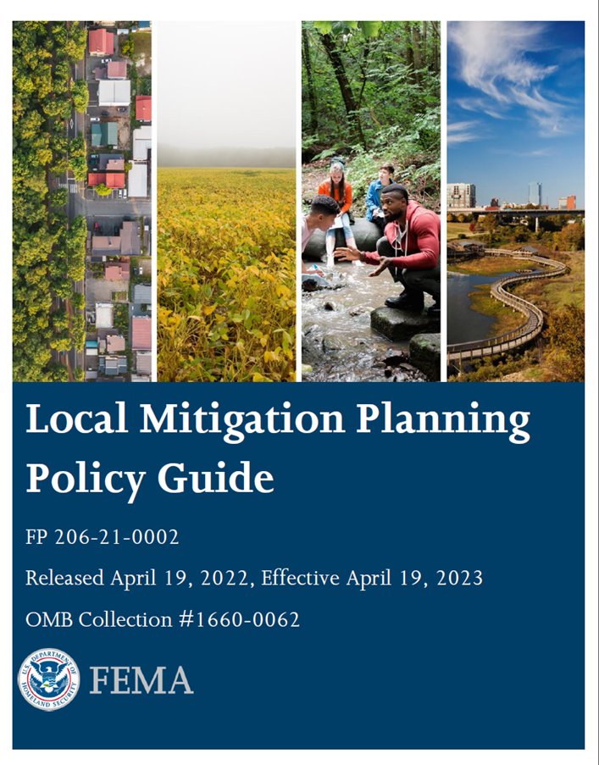
Sources of Ideas for Mitigation Actions
► Draft Hazard Identification & Risk Assessment
► Handout on action alternatives by hazard & category
► Public survey input
► Water protection & usage plans, watershed plans, drainage plans, etc.
► Capital Improvement Plan
► Community Wildfire Protection Plan
► FEMA ‘Mitigation Action Portfolio’ publication
https://www.fema.gov/sites/default/files/2020-08/fema_mitigation-action-portfolio-support-document_08-01-2020_0.pdf

Slide 42
Public Survey Results
Please indicate the types of mitigation actions that you think should have the highest priority.

Slide 43
Suggested Ideas for New Mitigation Actions
Install additional snow fences at strategic locations to minimize roadway impacts and transportation incidents
Create a water conservation public awareness and educational campaign, including educational materials on water conservation measures to implement during drought periods.
Implement the high priority projects identified in CWPPs or those that align with the Montana Forest Action Plan
Notification system for tourists for thunderstorms, fire, floods, and dam failure as visitors may not get emergency notifications on their phones.
Strategic grassland/forest fuels reduction efforts surrounding vulnerable communities
Ensure critical communication infrastructure is grounded to mitigate lightning strikes.
Underground utility lines
Provide indoor NOAA weather radios to critical facilities, community shelters, city facilities, schools and other identified areas.
Consult with USACE on potential large-scale flood mitigation projects

Slide 44
Activity: Develop New Mitigation Actions
What new mitigation actions should be added to the Plan?
Write one idea for each new action on a blank worksheet
You are encouraged to collaborate with other agencies or jurisdictions
Include details where you can, but it’s okay if you don’t know or can elaborate later.
Include the Jurisdiction and Lead Agency
Feel free to submit more than one
Review each other’s suggestions

Slide 45
Prioritization of Mitigation Actions

Slide 46
Mitigation Action Selection and Prioritization
STAPLEE
Social
Technical
Administrative
Political
Legal
Economic
Environmental
Other Factors to Consider
Life safety
Addressing high risk hazards
Protect critical facilities
Multiple goals/hazards
Vulnerable populations and equity

Slide 47
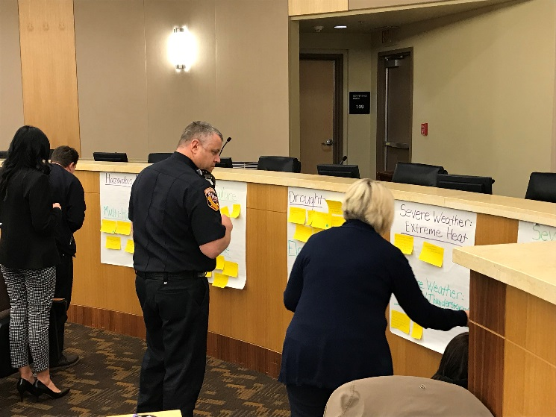
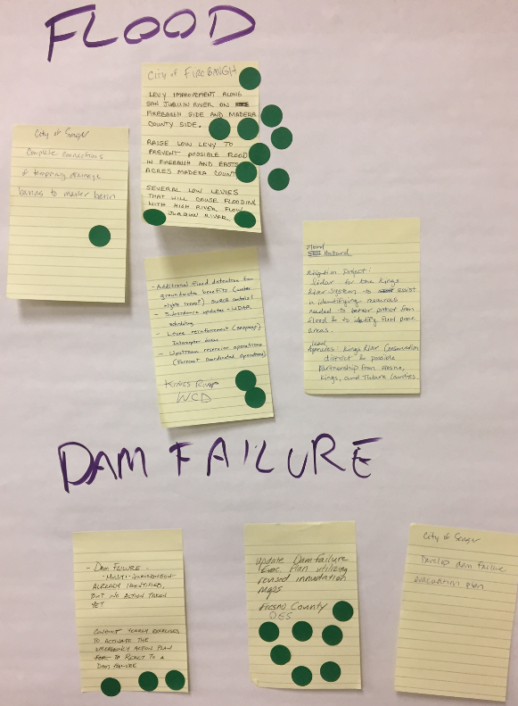
Activity: New Mitigation Action Prioritization
Connect the Dots!
4 Dots per Person
Indicate which should be priority mitigation actions with a dot, keeping STAPLEE Criteria in mind
Dots will later be converted into a High, Medium, Low initial prioritization
Notes:
What we will talk about today.

Slide 48
Plan Implementation and Maintenance

Slide 49
Plan Implementation & Maintenance
The plan must describe how, when, and by whom the plan will be:
Monitored:
Tracking implementation of mitigation actions
Identifying new actions as needed
Losses avoided due to mitigation activities
Evaluated
Effectiveness at achieving goals and objectives
What hindered implementation?
What factors contributed to success?
Updated
Reviewed & revised at least once every five years.
Continued Public Involvement
Engaged and given opportunity to provide input

Slide 50
Plan Implementation & Maintenance
The following tasks should be conducted “regularly”, at least annually
HIRA review – changes to hazards or vulnerabilities
Review of recent hazard incidents
Updates on mitigation actions
Assess effectiveness of completed mitigation actions
Annual face to face meeting of Hazard Mitigation Planning Team to discuss updates on mitigation actions and/or significant impactors/events
Target is first quarter of each year?
Job aids:
Sample agenda for annual meeting in appendix

Slide 51
Incorporation into Other Planning Mechanisms
Mitigation is most successful when it is incorporated into the day-to-day functions and priorities of government and development.
Implementation through existing plans and/or programs is recommended wherever possible:
Comprehensive Plan
Zoning/Subdivision Ordinances
Floodplain Ordinance
Capital Improvements Plan
Emergency Operations Plan
Discussion: Provide at least one opportunity to incorporate or cross reference the HMP into other planning mechanisms
FEMA Requirement – Element C6
a. Does the plan identify the local planning mechanisms where hazard mitigation information and/or actions may be incorporated?
b. Does the plan describe each community’s process to integrate the data, information, and hazard mitigation goals and actions into other planning mechanisms?
c. The updated plan must explain how the jurisdiction(s) incorporated the mitigation plan, when appropriate, into other planning mechanisms as a demonstration of progress in local hazard mitigation efforts.

Slide 52
Review of Draft HIRA

Slide 53
DRAFT Hazard Identification & Risk Assessment
Provided for planning team review Nov-Dec
It is critical we get your feedback and input – it’s YOUR plan!
Review both for the region as a whole and for your jurisdiction specifically
Feedback will be incorporated into full draft and presented for review

Slide 54
Western Region Hazards – DRAFT Significance Rankings
Hazard | Geographic Area | Magnitude/ Severity | Probability | Significance
Avalanche | Extensive | Limited | Highly Likely | Low
Communicable Disease | Extensive | Critical | Occasional | Medium
Cyber-Attack | Significant | Critical | Occasional | Medium
Dam Failure | Significant | Critical | Unlikely | Medium
Drought | Extensive | Critical | Highly Likely | High
Earthquake | Extensive | Critical | Likely | Medium
Flooding | Significant | Critical | Likely | High
Hazardous Material Incidents | Limited | Negligible | Likely | Low
Landslide | Limited | Negligible | Likely | Low
Severe Summer Weather | Extensive | Moderate | Highly Likely | Medium
Severe Winter Weather | Extensive | Moderate | Highly Likely | Medium
Human Conflict | Limited | Critical | Likely | Medium
Tornadoes/Windstorms | Extensive | Moderate | Highly Likely | Medium
Transportation Accidents | Significant | Negligible | Highly Likely | Low
Volcanic Ash | Extensive | Moderate | Unlikely | Low
Wildland/Rangeland Fire | Extensive | Critical | Highly Likely | High

Slide 55
Next Steps

Slide 56
Project Schedule
Project Milestones | Anticipated Timeline
Meeting #2 HIRA review | September 2022
HIRA Draft for HMPC review | November 2022
Meeting #3 Mitigation Strategy | January
Full Draft for HMPC review | March-April
Public Review Draft | April
DES Review Draft | May – June
Final Plan for FEMA Review (estimated) | July – August
Final Approved HMP for local adoption | August – September

Slide 57
Next Steps
Please return Plan Update Guide if you haven’t already
Provide input on mitigation action statuses
Submit additional new mitigation actions
Review and comment on HIRA if you haven’t already
And full draft plan when available
Think about what local-level Objectives you may want to adopt to supplement the plan’s Goals
Stay informed by email of upcoming meetings

Slide 58
Questions? Thank you!
Project Manager
Jeff Brislawn
WSP
Jeff.Brislawn@wsp.com
303-704-5506
Western Region Project Manager/
Mitigation Coordinator
Andrew Long
Montana DES
Andrew.Long@mt.gov
406-202-4532
Lead Planner
Christopher Johnson
WSP
Christopher.johnson@wsp.com
wsp.com

